Slide 1
The Parklands of Floyd’s Fork - Phase 3A - Echo Trail & Park Rd.
Retaining Wall Design
Redi-Rock PC System

Slide 2
Redi-rock system overview

Slide 3
Redi-Rock Retaining Wall Units

Slide 4
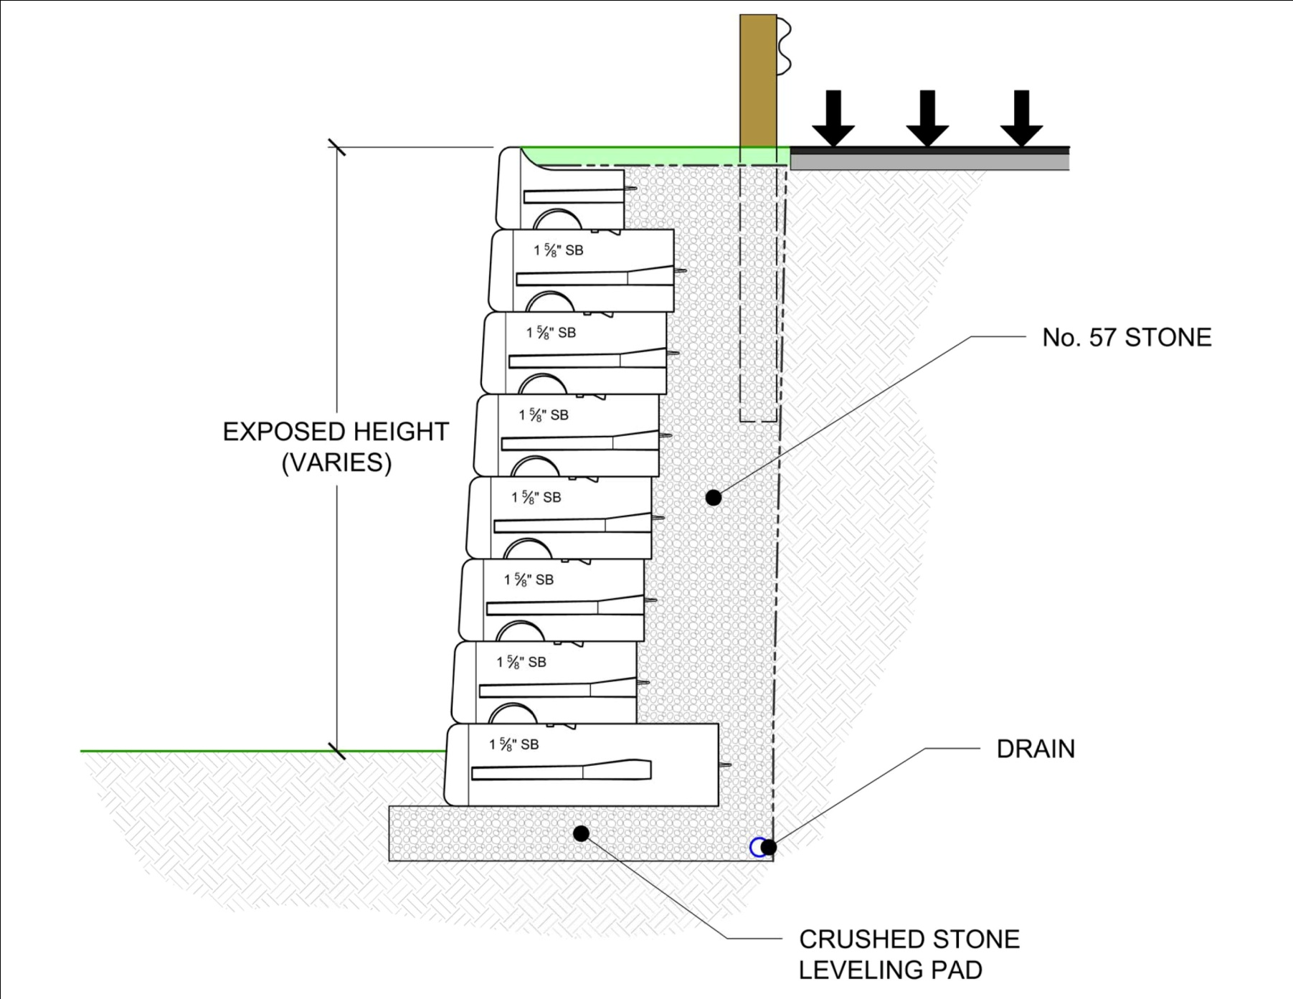
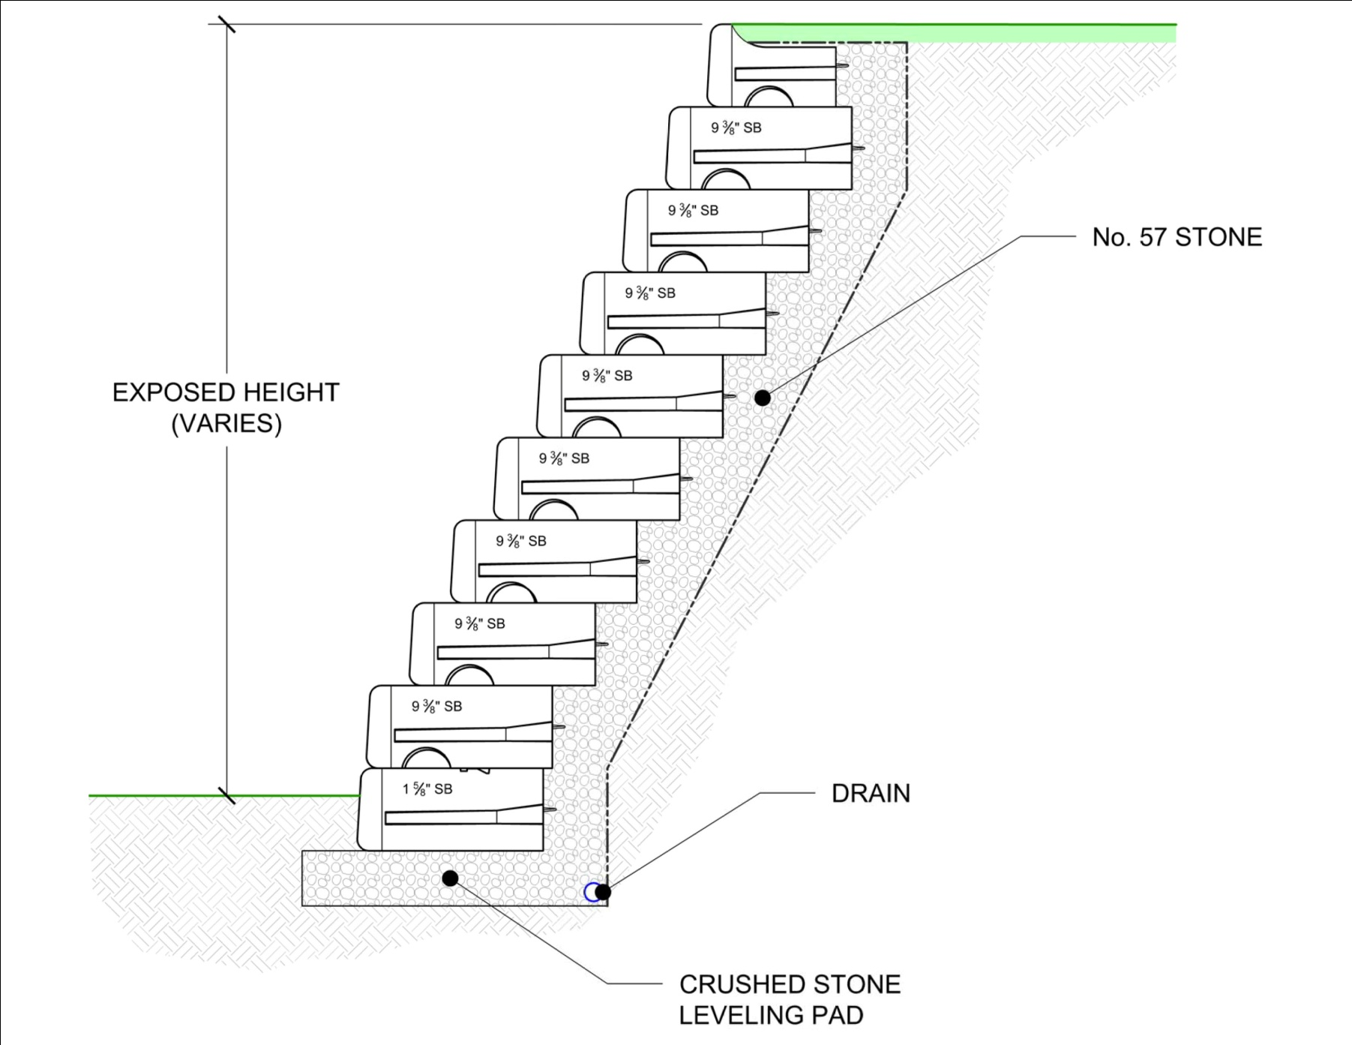
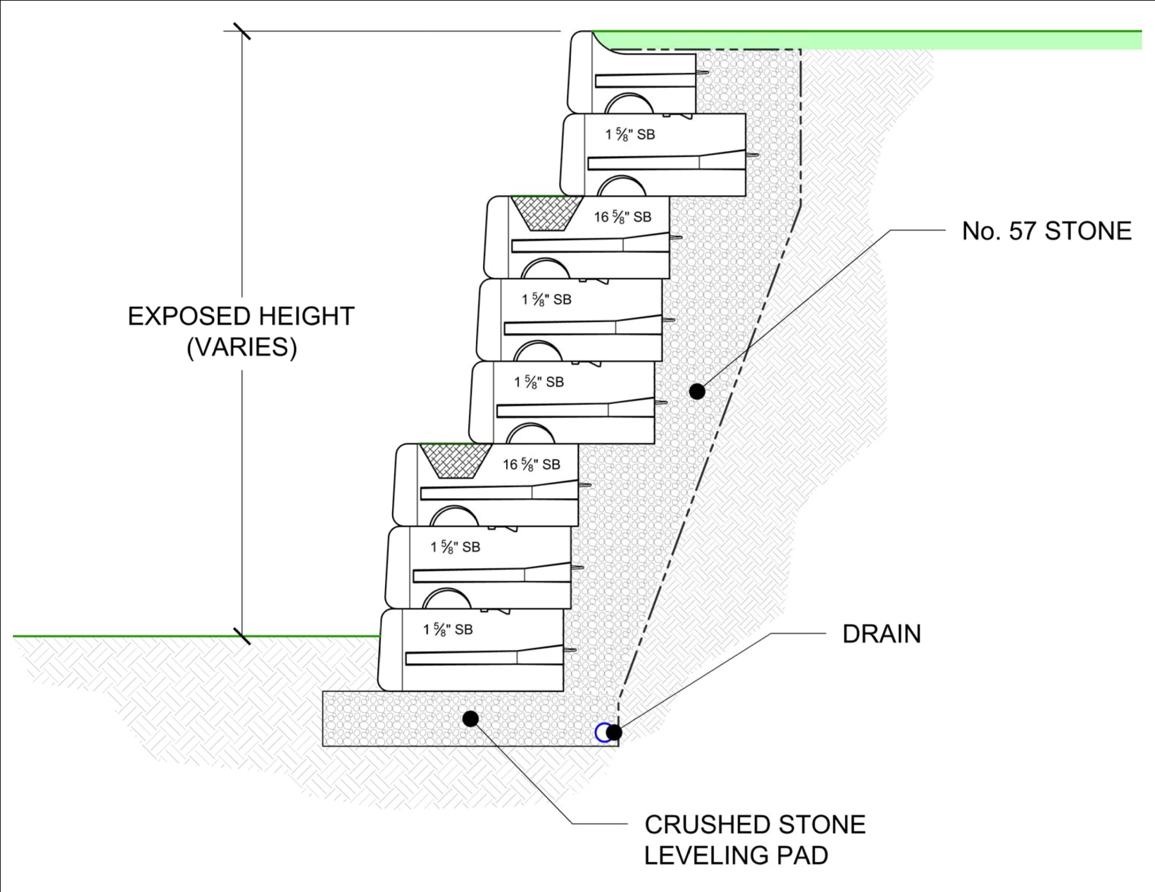
Redi-Rock Gravity Walls

Slide 5
Redi-Rock Gravity Walls

Slide 6
Redi-Rock Gravity Wall

Slide 7
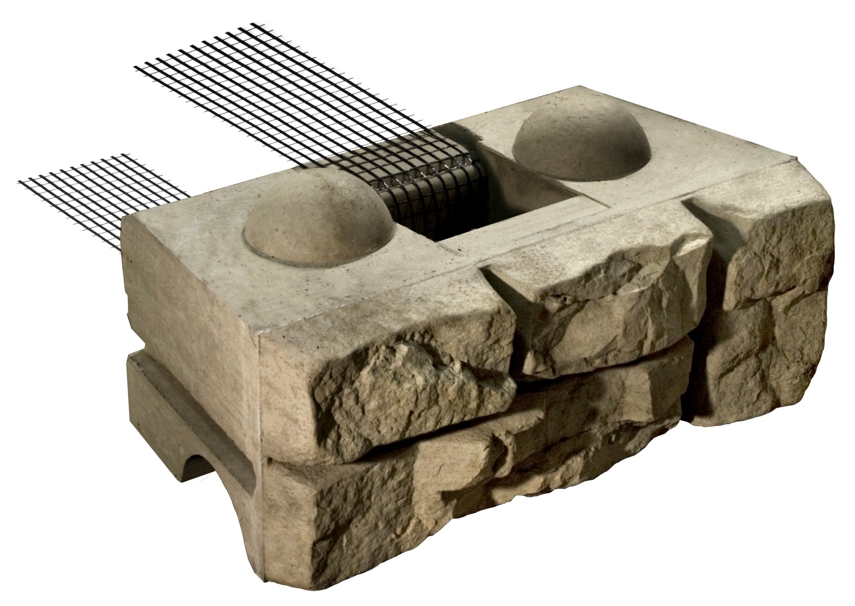
Positive Connection System
Total of 2 Components

Slide 8
Positive Connection System

Slide 9
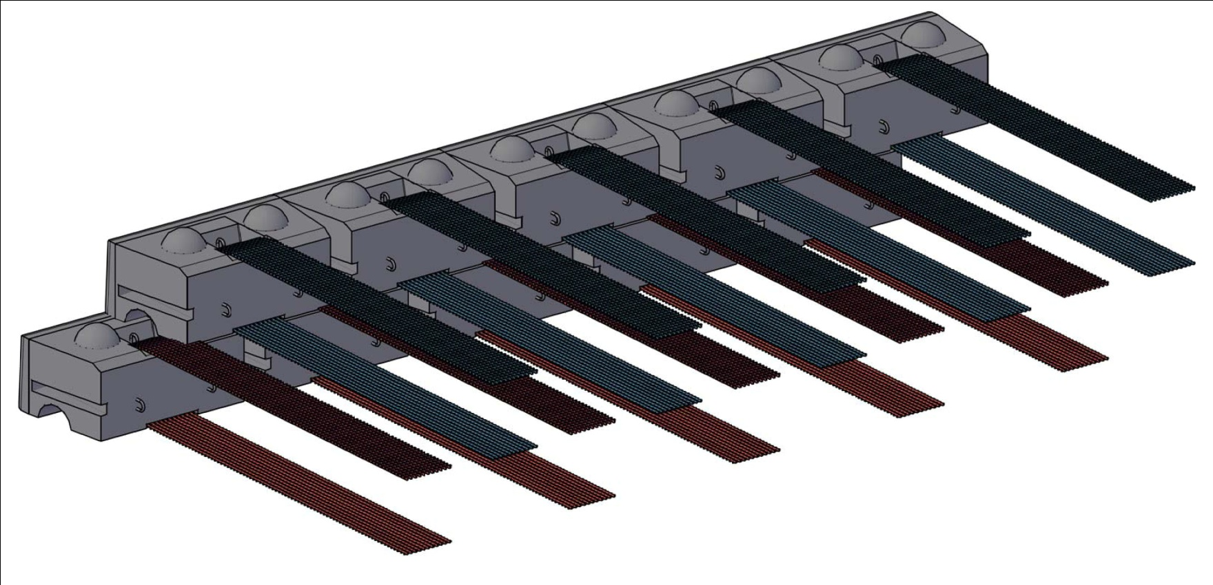
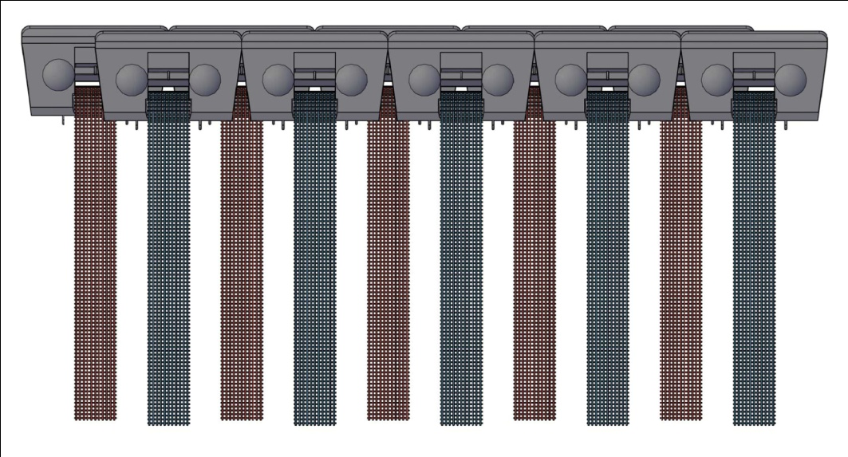
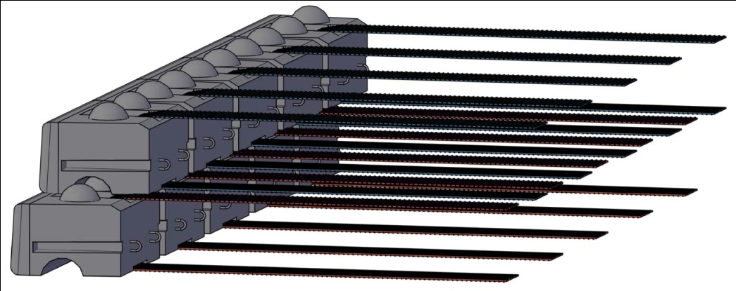
Positive Connection System
BACK VIEW
TOP VIEW
SIDE VIEW

Slide 10
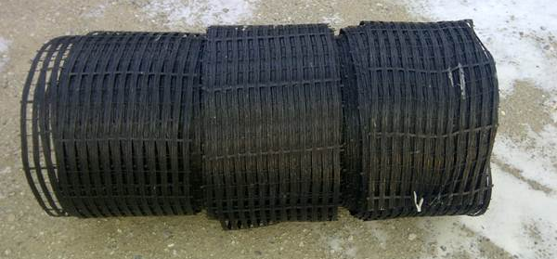
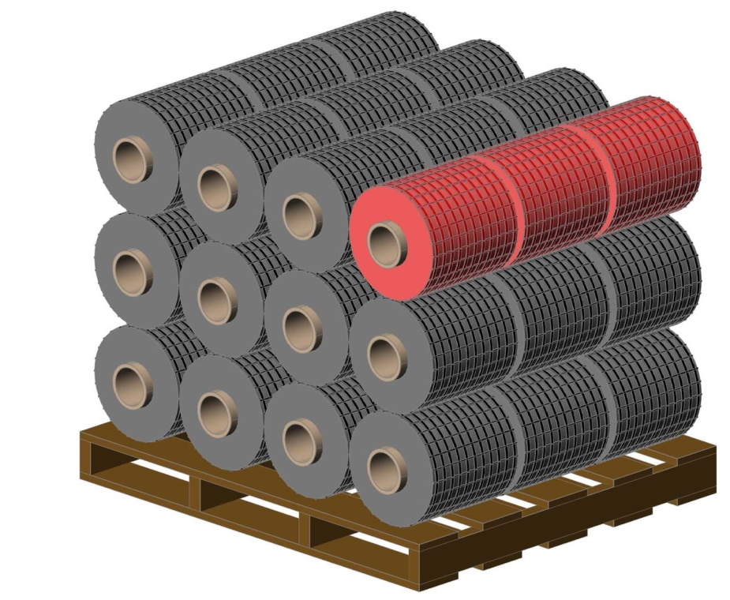
Positive Connection System
Miragrid XT Geogrid
100% corrosion resistant
NTPEP evaluated product line
12” custom roll width
Certified custom roll tensile strength
Broad range of tensile strengths: 4,700 lbs./ft. to 27,400 lbs./ft.
Manufactured in the United States
Manufactured by TenCate Mirafi - the world’s largest provider of geosynthetic products
In-house GAI accredited lab testing facility for geosynthetics

Slide 11
Positive Connection System

Slide 12
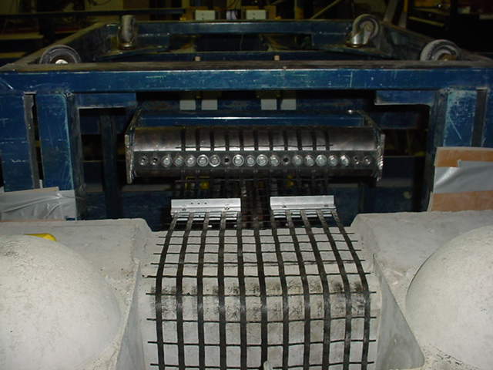
Positive Connection System
ASTM D6638 – “Quick Test”
Full-Scale Testing

Slide 13
Positive Connection System

Slide 14
Positive Connection System

Slide 15
the parklands – phase 3a
Echo Trail & Park Road

Slide 16
Project Location

Slide 17
Project Team
Owner: 21st Century Parks, Inc. – Louisville, KY
Consultant/Landscape Architect:
Wallace Roberts & Todd, LLC – Philadelphia, PA
Site Civil & Structural Engineer: QK4 – Lousiville, KY
Architect: Bravura Corporation – Louisville, KY
Geotechnical Engineer: Stantec Consulting Services, Inc. – Louisville, KY
General Contractor: Louisville Paving & Construction Co. – Louisville, KY
Foundation Soils/Undercut Geotechnical Engineer:
Mattingly Engineers – Prospect, KY
Redi-Rock Manufacturer & Installation Contractor:
Redi-Rock of Kentuckiana – Mt. Washington, KY
Redi-Rock Retaining Wall Design Engineer:
JC Hines & Associates, LLC – Cincinnati, OH

Slide 18
Wall Plan Layout

Slide 19
Redi-Rock Retaining Wall Schedule
WALL | FACE AREA | LENGTH | MAX. HEIGHT
1 | 9,911 s.f. | 452 l.f. | 41 ft.
2 | 4,385 s.f. | 292 l.f. | 26 ft.
3 | 6,681 s.f. | 371 l.f. | 26 ft.
TOTAL | 20,977 s.f. | 1,115 l.f.

Slide 20
Design Challenges
Tall Retaining Walls (41’ max.) = High bearing pressure
Marginal Foundation Soils = Settlement Potential
Vertical wall face requirement (no batter/set-back)
Back-to-Back Wall Structures = Overlapping Reinforced Zone
2-tiered wall separating the bicycle path from Park Road
Complex geometry/layout – exact transition with adjacent structures
Through-wall cross-drains at 2 locations
Custom block manufacturing
AASHTO LRFD Design Methodology

Slide 21
Foundation Soils
Clay (CL) soils
LL = 41 to 47
PI = 23 to 29
SPT (N) = 4 to 11 @ B.O.W. (soft to medium stiff)
Rock Depth: approx. 10’ below B.O.W.
Undrained Shear Strength = 2,180 psf to 3,120 psf
Max. Applied Bearing Pressure of the Redi-Rock Wall
= 6,200 psf +/-
*Soil data provided from “Report of Subsurface Exploration”, dated 12/21/11 and Addendum dated 4/13/12 prepared by STANTEC Consulting Services Inc.

Slide 22
Undercut & Replacement
3’ to 4’ below B.O.W.
Replacement w/ #57 crushed stone
KYTC Type IV woven geotextile separator
Biaxial Geogrid @ 12” vertical lifts

Slide 23
Back-to-Back Walls

Slide 24
Back-to-Back Walls

Slide 25
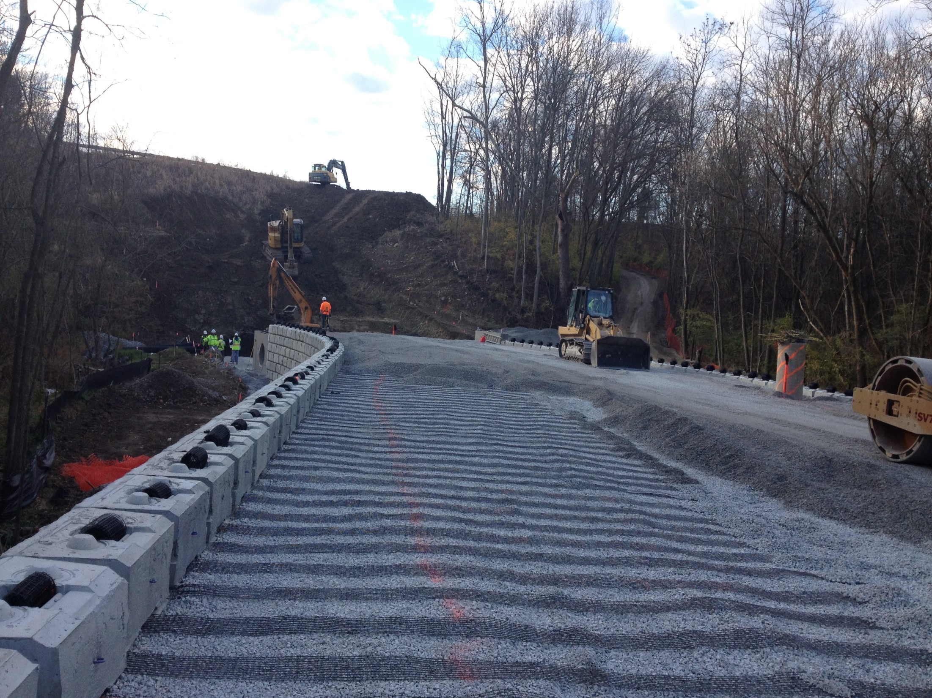

Slide 26
41-ft. Vertical Wall Face

Slide 27
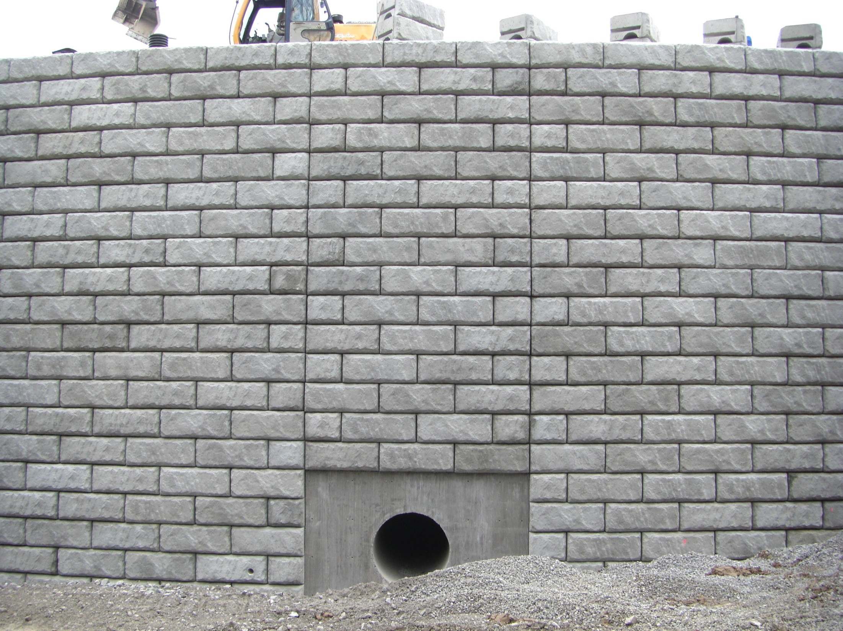

Slide 28
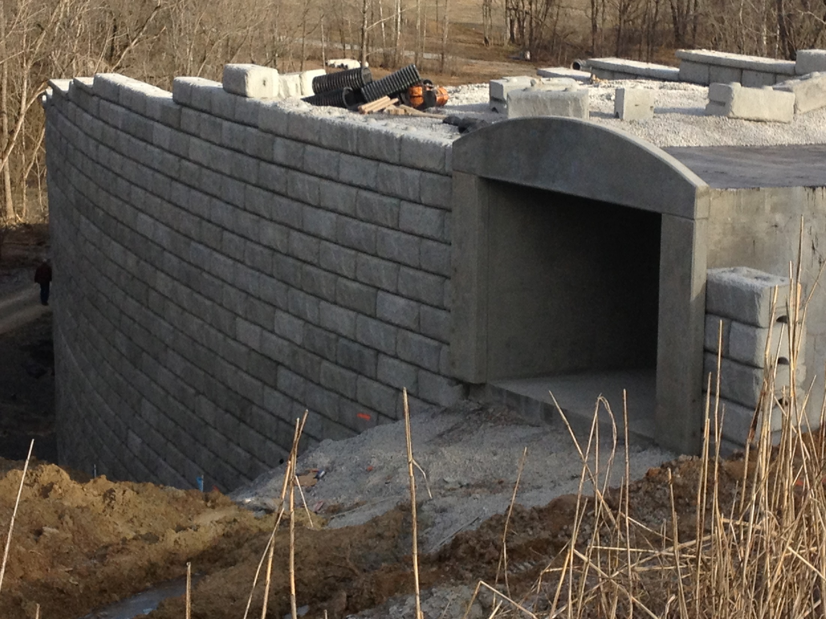

Slide 29
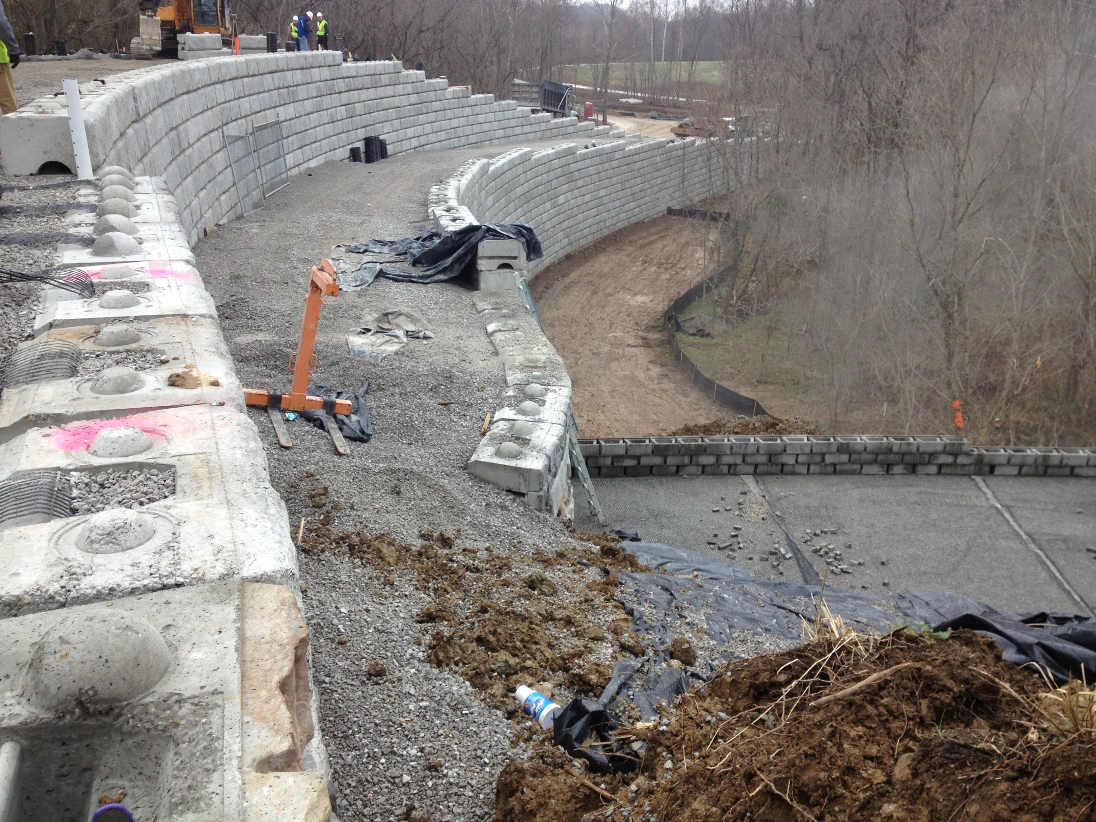

Slide 30
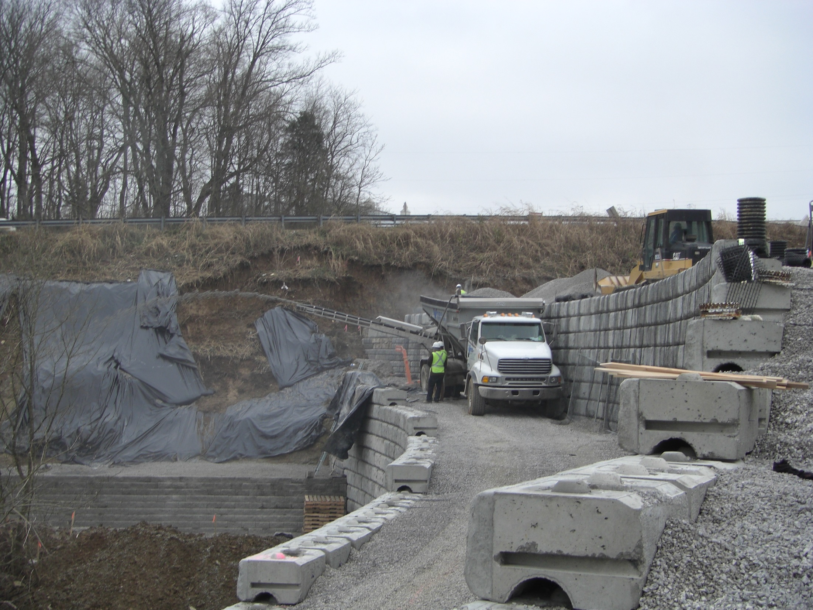

Slide 31
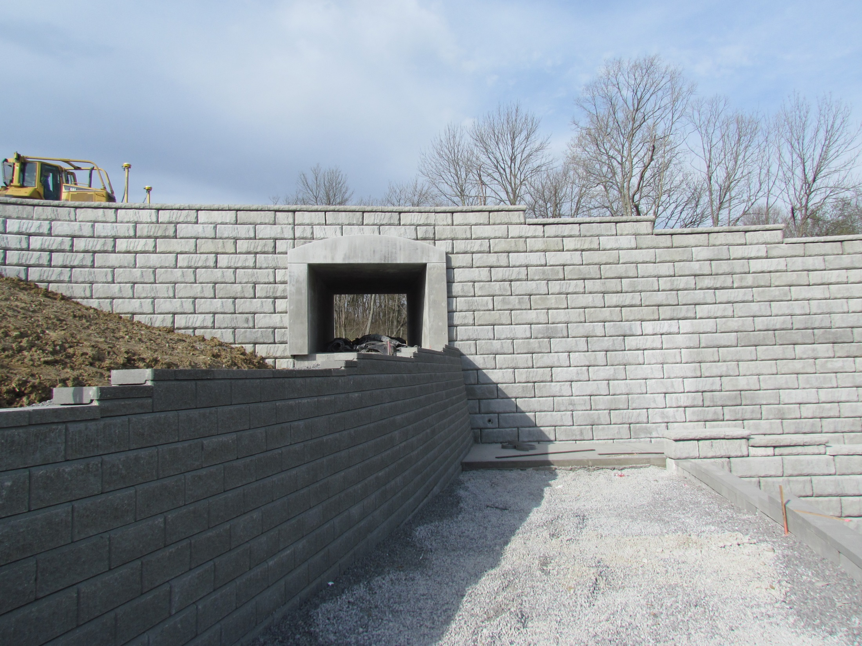

Slide 33
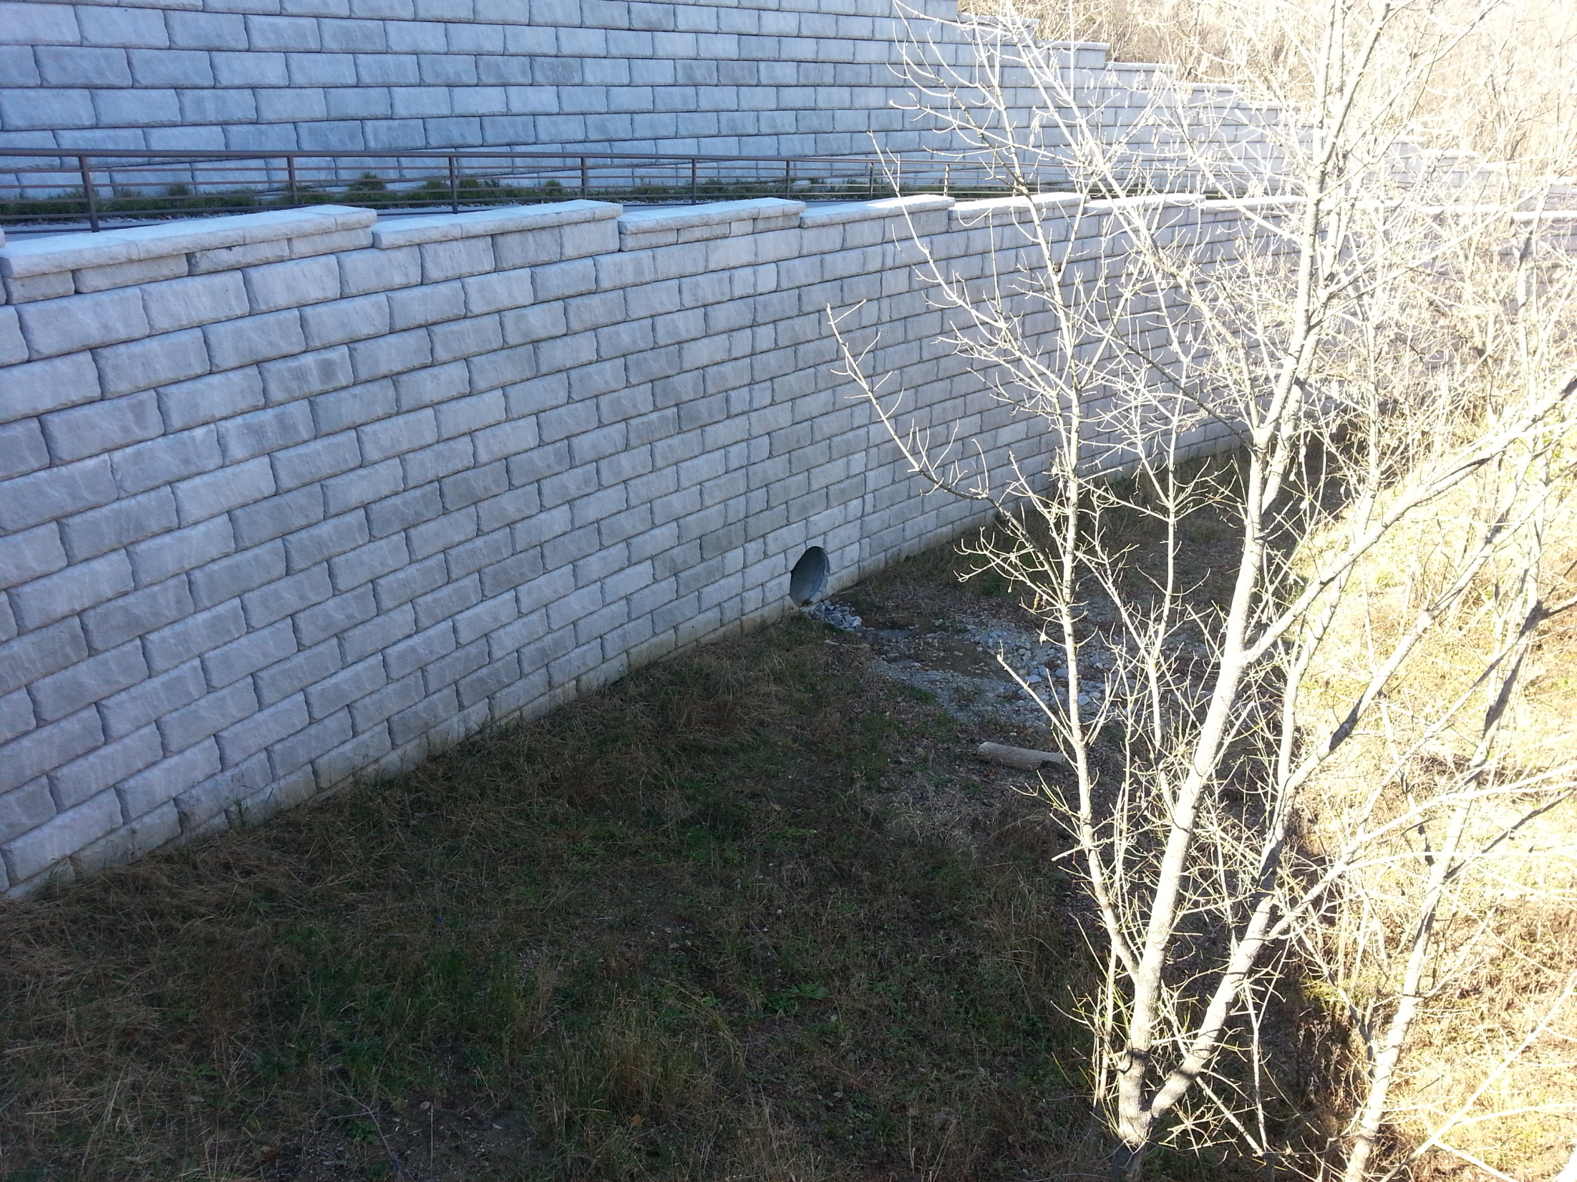

Slide 34
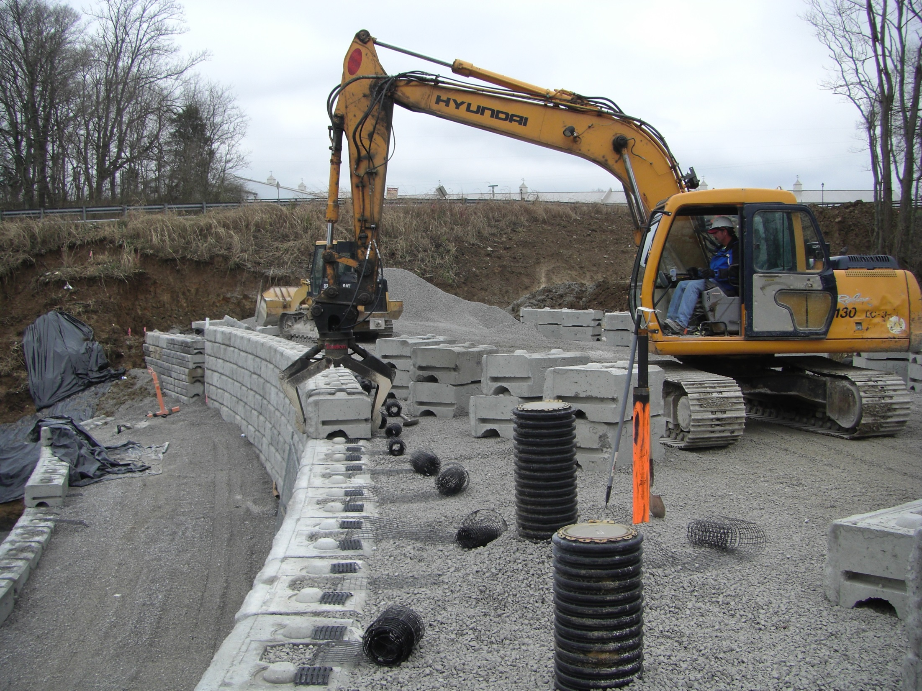

Slide 35
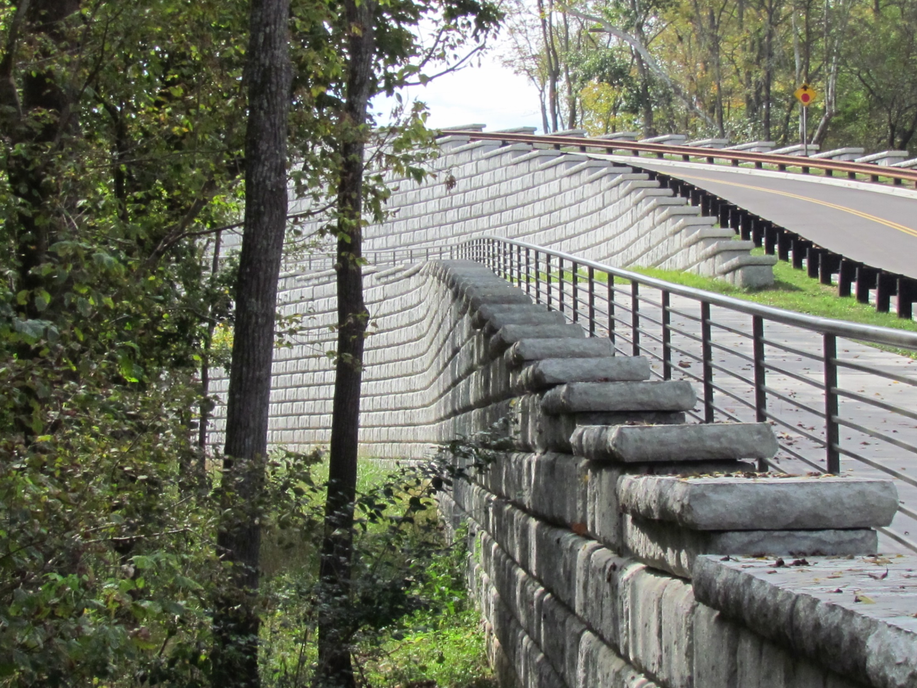

Slide 36
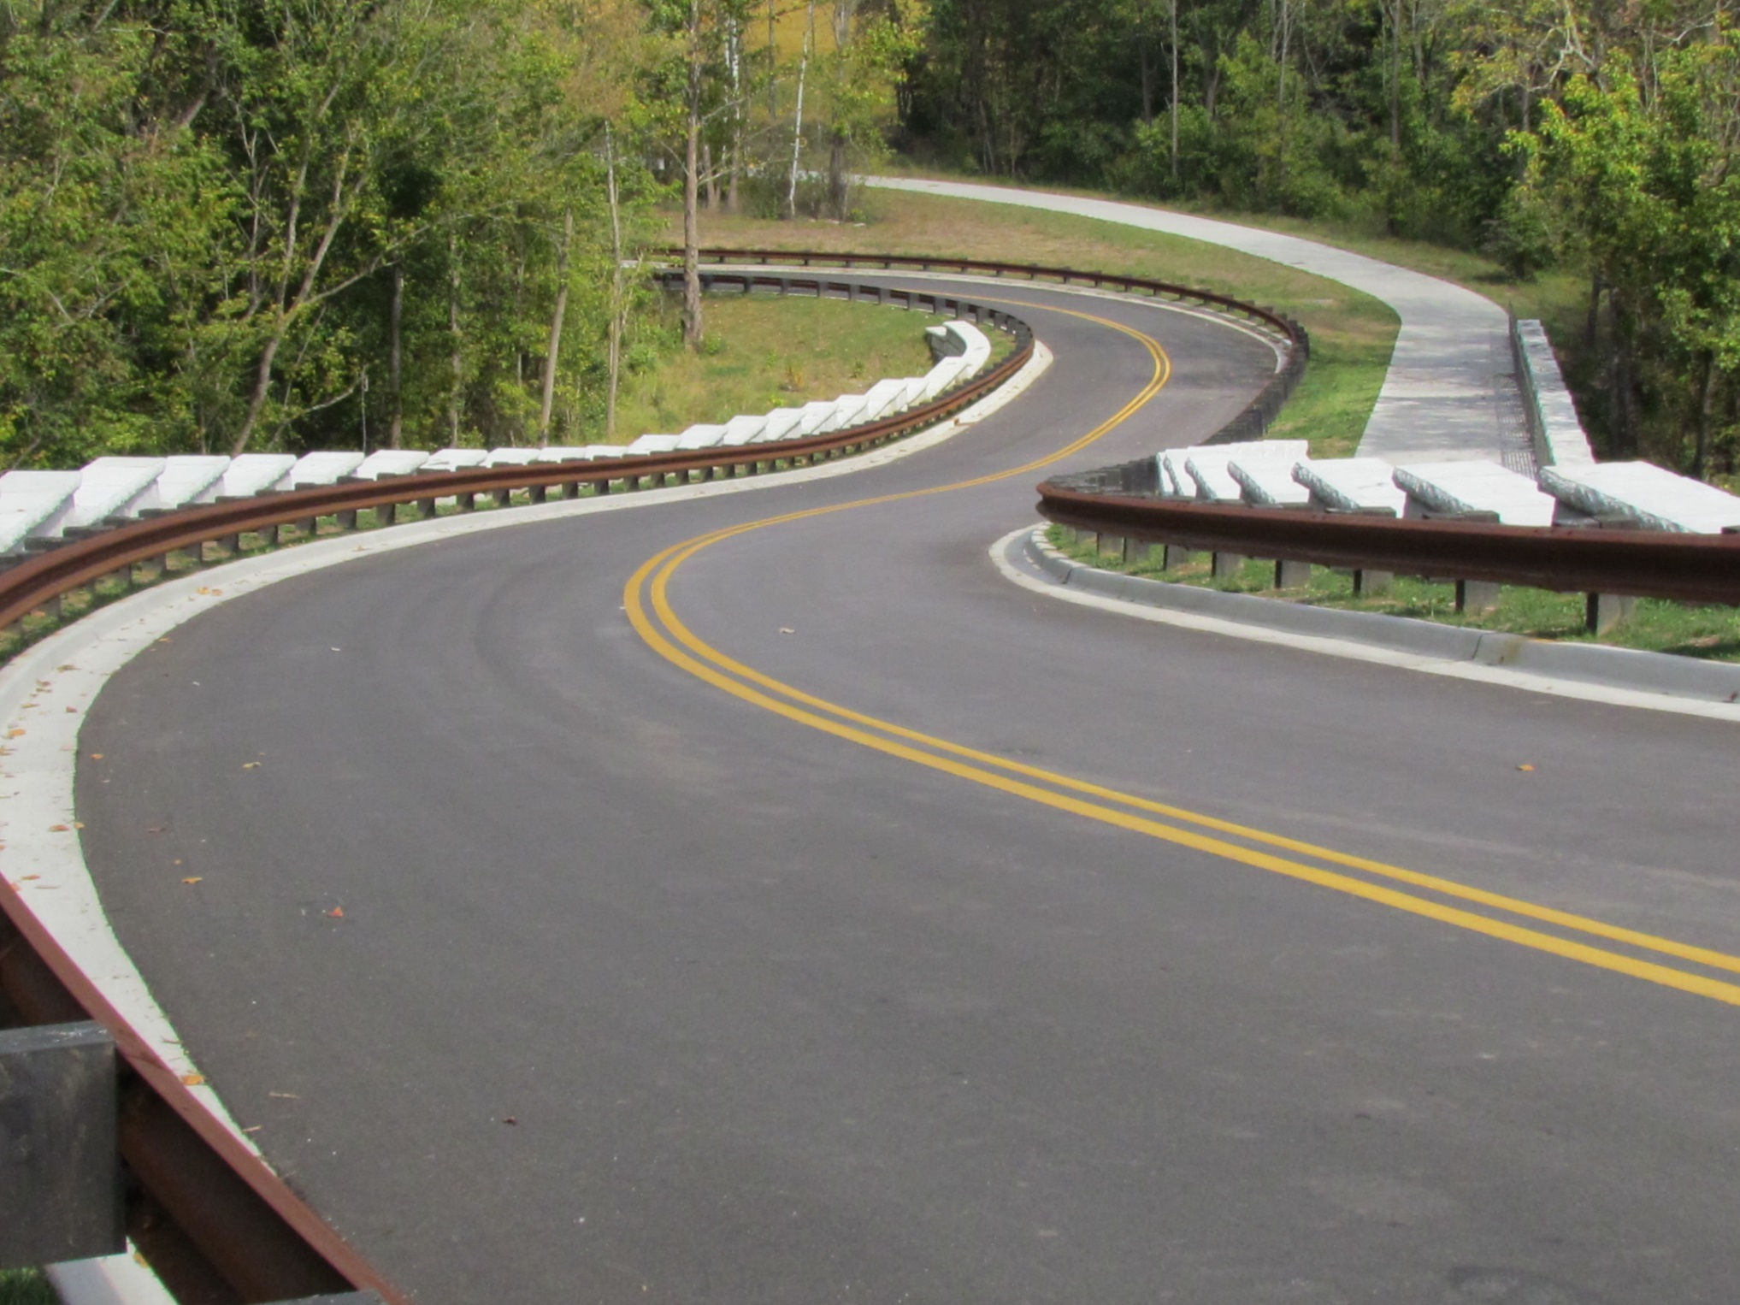

Slide 37
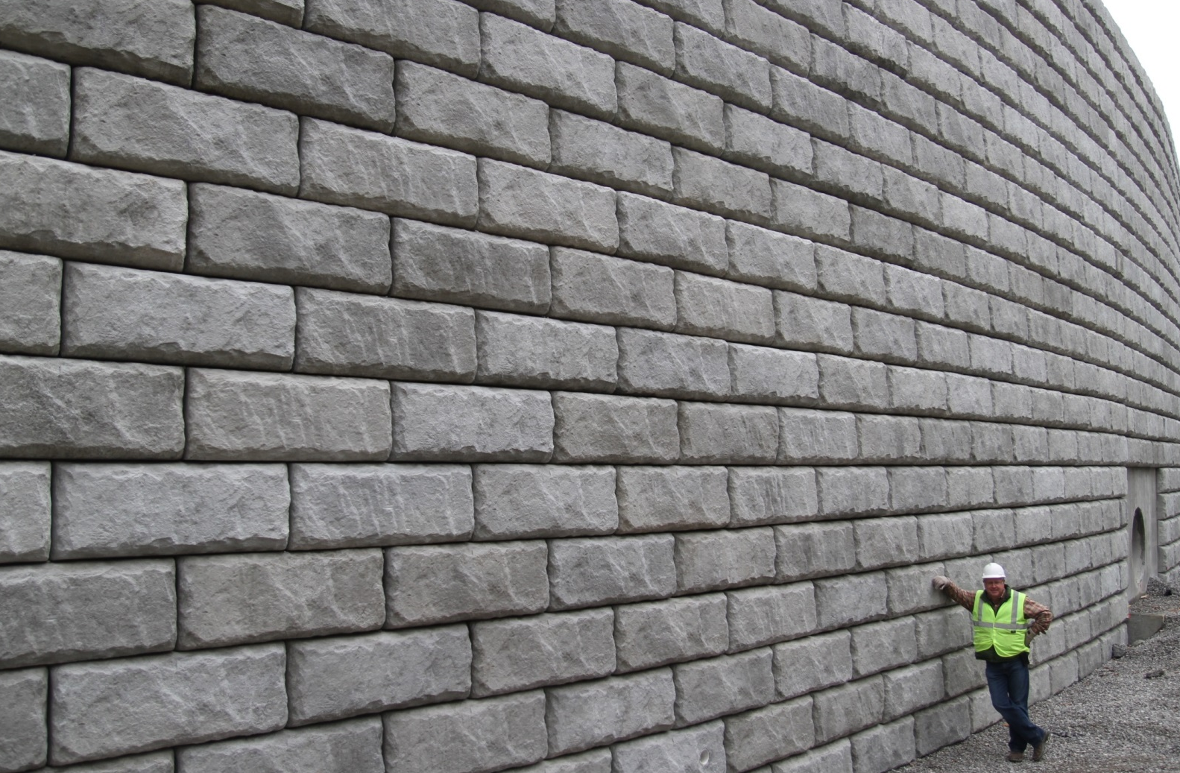
Questions?

